Slide 1
Object-Oriented Principles
Endre Ferencz
Endre_Ferencz@epam.com

Slide 2
Agenda
Introduction
Design UML Class diagram for the traveling domain
Object-Oriented Principles
Redesign the Class diagram

Slide 3
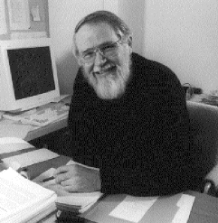
Before we start
Controlling complexity is the essence of computer programming
Brian Kernighan

Slide 4
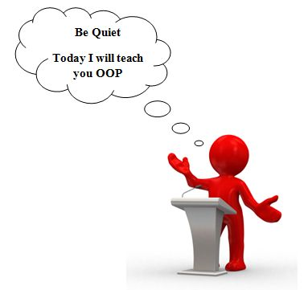
Introduction
Object-Oriented Principles

Slide 5
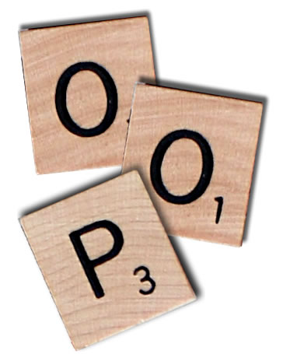
What's the point of OOP?
I don't think object-oriented programming is a structuring paradigm that meets my standards of elegance
(1999, Edsger Dijkstra)

Slide 6
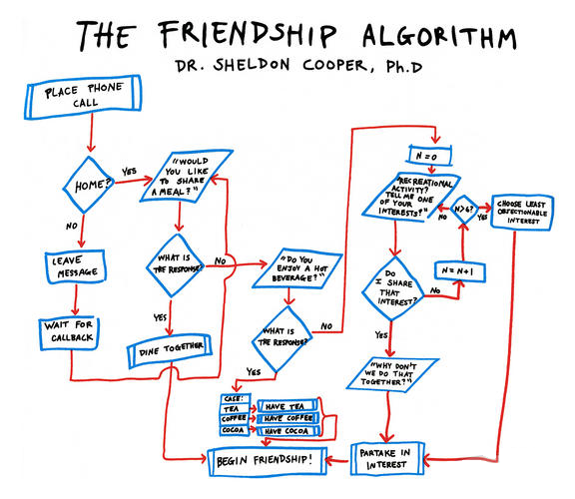
Functional decomposition
Functional decomposition is a natural way to deal with complexity
Notes:
Task: writing code to access a description of shapes that were stored in a database and then display them
Steps:
1. Locate the list of shapes in the database.
2. Open up the list of shapes.
3. Sort the list according to some rules.
4. Display the individual shapes on the monitor.
Break down the steps:
4a. Identify type of shape.
4b. Get location of shape.
4c. Call appropriate function that will display shape, giving it the
shape’s location.

Slide 7

The challenge
Dealing with change
Notes:
Change creates opportunities for mistakes and unintended consequences.

Slide 8

Things change
Requirements always change
And nothing you can do will stop change…
… but you do not have to be overcome by it
Notes:
You can never get all of the requirements from the user.
Too much is unknown about the future.
Rather than complaining about changing requirements, we should change the development process so that we can address change more effectively.

Slide 9
Solution: Modularity
Using modularity to contain variation
main
data
module1
module2
module3
data
data
data
Notes:
Rather than writing one large function, I could make it more modular.
Isolate the problem.
Then, when I receive a requirement to be able to display a new type of shape—a triangle, for instance—I only need to change this module (hopefully!).
Modularity definitely helps to make the code more understandable.

Slide 10
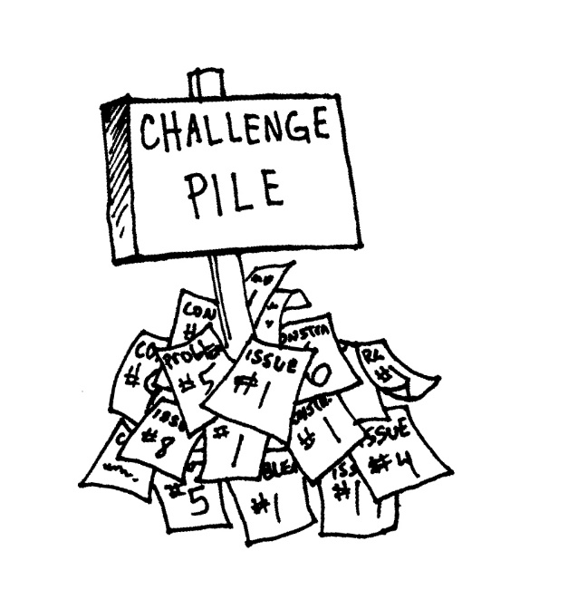
Challenge pile
Low cohesion
the operations in a module are not closely related
Tight coupling
the connection is too strong between the modules
Notes:
Unexpected impact.
Cohesion:
Coincidental cohesion (worst)
Logical cohesion
Temporal cohesion
Procedural cohesion
Communicational/informational cohesion
Sequential cohesion
Functional cohesion (best)

Slide 11
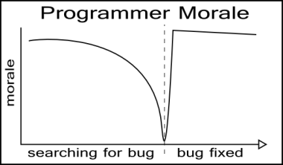
Bugs
Changing a function, or even data used by a function, can wreak havoc on other functions
The devil is in the side effects
We really do not want to spend too much time fixing bugs
Notes:
Task: make sure everyone knows how to get to their next class
SolutionModular:
1. Get list of people in the class.
2. For each person on this list:
2a. Find the next class they are taking.
2b. Find the location of that class.
2c. Find the way to get from your classroom to the person’s next class
2d. Tell the person how to get to their next class.
You have to pay close attention to a lot of details!

Slide 12
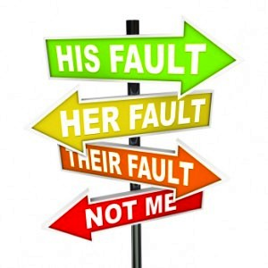
The object-oriented way
Shifting responsibility from yourself to individuals
Can localize changes
Notes:
SolutionOO: I have posted the locations of the classes following this in the back of the room, as well as the locations of the other classrooms. Please use them to go to your next classroom.
Give general instructions and then expect that each person will figure out how to do the task himself or herself.

Slide 13
The objects
Are responsible for themselves
Shift responsibility to a more local level
The control program can talk to different types of objects uniformly
The control program does not need to know about the special steps

Slide 14
The object
Conceptual level
set of responsibilities
Specification level
a set of methods
Implementation level
code and data
Abstract
Concrete

Slide 15
Design Approach
Responsibility-driven design
Delegated control
Coordinators
Higher-level messages
Few smart objects
Rule-Based Design
Artificial intelligence applications
Ad-Hoc Design
Non-generalizable
Data-Driven Design
Centralized control
Controllers
Low-level messages
Lots of simplistic information holders
Event-Driven Design
Asynchronous environment
Triggers fired on incoming events
Extreme loose coupling

Slide 16
Software quality, External factors
Correctness: perform the exact tasks defined by the specification
Robustness: react appropriately to abnormal conditions
Extendibility: adaptability to changes of specification
Maintainability: ease of modification, understandability
Reusability: elements serve for the construction of different applications
Functionality: extent of possibilities provided by a system
Compatibility, portability, ease of use
Performance
Notes:
OOP is better for: Extendibility, Maintainability, Reusability

Slide 17
Exercise
Object-Oriented Principles

Slide 18
Traveling domain
Passengers book trips for certain flights. Multiple passengers can form a group. The flights are selected based on flight date and fare. The fare depends on booking class and booking date.
Passengers pay the tickets. Before each flight they check in when get their seat and also check the luggage in.
They can book and cancel their trips and can get point based on their current frequent flyer category.

Slide 19
Basic requirements
Use cases
Passengers can pay the tickets
Passengers can collect miles points for a trip
Passengers can get discount based on Frequent Flier program
Passengers get promoted if enough points are collected

Slide 20
Object-oriented Principles
Object-oriented Principles

Slide 21
Core OO concepts
Abstraction
Polymorphism
Inheritance
Encapsulation and Information hiding

Slide 22
Encapsulation and Information hiding
Encapsulation
Bundle data with the operations
Information hiding
Hiding implementation details (not just the attributes)
Hiding internal concepts
Protect components of the object from external entities

Slide 23
Abstraction
Definition
Preserving information that is relevant in a given context, and forgetting information that is irrelevant in that context

Slide 24
Abstraction
Source: Object-Oriented Analysis and Design with Applications, Addison-Wesley

Slide 25
Usage of Abstraction
Managing complexity
Modeling a concept
Use abstractions whenever suitable in order to avoid duplication
Represent an unbounded group of possible behaviours
Abstract entities are the most stable in the system

Slide 26
Inheritance
Deriving a new class from an existing one
Strongest relationship between classes
Usage
Mechanism for code reuse
Establishes an is-a relationship
Allow independent extensions of the original class

Slide 27
Polymorphism
Provision of a single interface to entities of different types
Kinds of polymorphism
function overloading
generic programming
function override (OO polymorphism)

Slide 28




Possible relationships
Inheritance
Implementation
Composition
Aggregation
Association
Dependency
extends
implements
~ field
~ may be affected

Slide 29
Inheritance vs. Composition
Prefer composition over inheritance
Strive for loosely coupled components
Isolate changes
Composition may change dynamically (relationship between objects)
HAS-A can be better than an IS-A relationship
Drawbacks
Additional complexity (dynamic relationship)
May be an imperfect design

Slide 30
Coupling and Cohesion
Coupling
Changing one module in a program requires changing another module
Cohesion
Degree to which the elements of a module belong together
High cohesion often correlates with loose coupling

Slide 31
Exercise
Analyze the dependencies in the given project
Refactor the code

Slide 32
SOLID principles
Single responsibility principle
Open/closed principle
Liskov substitution principle
Interface segregation principle
Dependency inversion principle

Slide 33
Single responsibility principle
Every class should have a single responsibility, and that responsibility should be entirely encapsulated by the class
The class should have one, and only one, reason to change
Motivation
Make the class more robust
Avoid coupled responsibilities

Slide 34
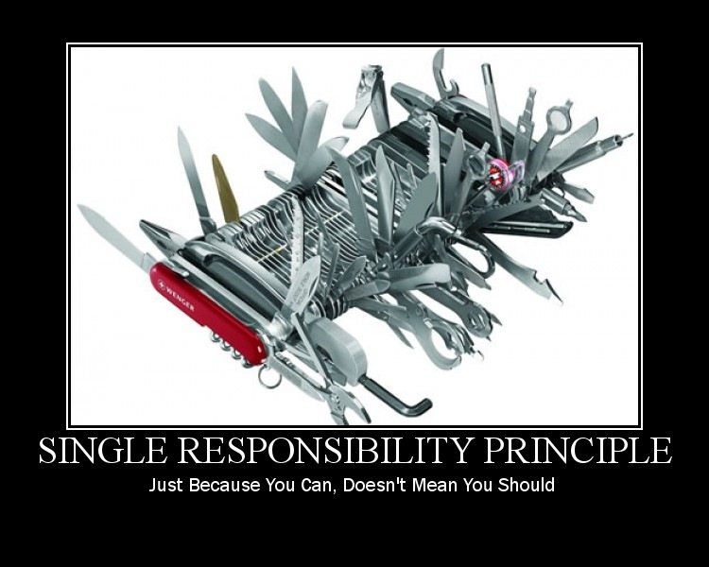
Single responsibility principle - Exercise

Slide 35
Open/closed principle
Software entities should be open for extension, but closed for modification
Closed for modification
Changing the behaviour of a class has an impact on the clients that use this class
Open for extension
Write code in a fashion that adding new functionality would involve minimal changes to existing code
Solution
Use abstractions: are fixed and represent an unbounded group of possible behaviours

Slide 36

Open/closed principle - Exercise

Slide 37
Liskov substitution principle
Derived types must be completely substitutable for their base types
Consume any implementation without changing the correctness of the system
Conditions
Method signature
Preconditions cannot be strengthened in a subtype
Postconditions cannot be weakened in a subtype
Invariants of the supertype must be preserved in a subtype
History constraint
Motivation
Unexpected behaviour may occur

Slide 38
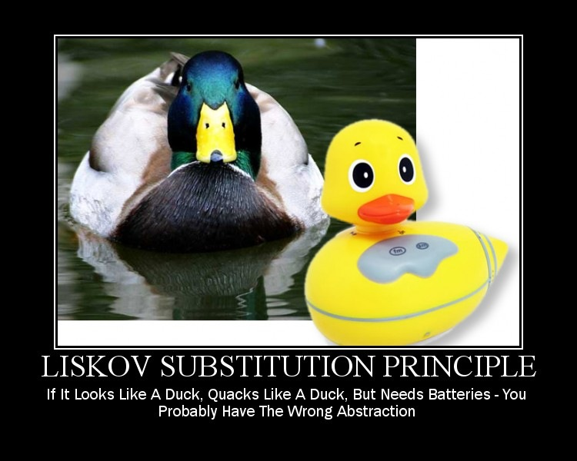
Liskov substitution principle - Exercise

Slide 39
Interface segregation principle
Clients should not be forced to depend on methods they do not use
Favour Role interfaces over Header interfaces
Motivation
Keep a system decoupled and thus easier to refactor, change, and redeploy
When clients are forced to depend upon interfaces that they don’t use, then those clients are subject to changes to those interfaces

Slide 40
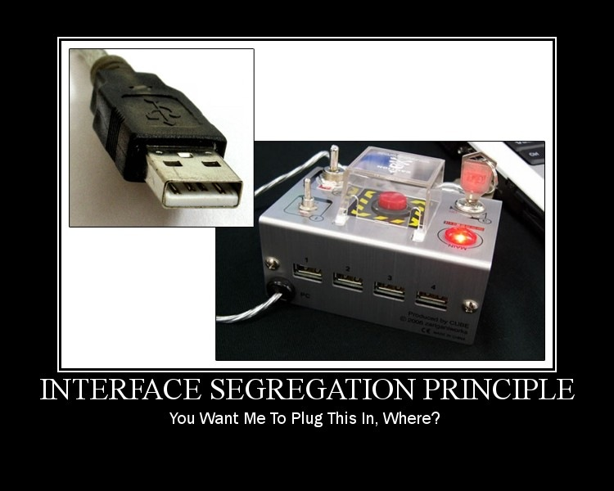
Interface segregation principle - Exercise

Slide 41
Dependency inversion principle
High-level modules should not depend on low-level modules. Both should depend on abstractions.
Abstractions should not depend upon details. Details should depend upon abstractions.
Solution
Define abstract interfaces for low level components
Resolve dependencies upon object construction (or use an IoC container)

Slide 42
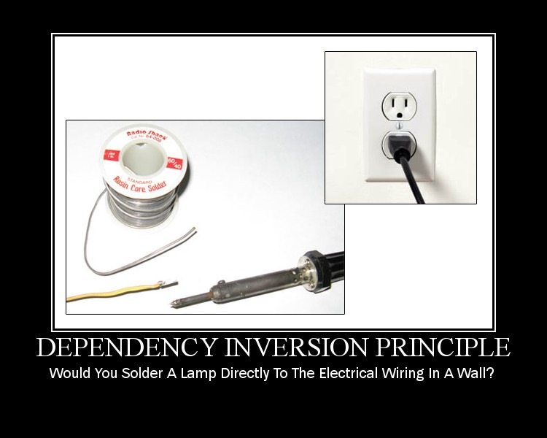
Dependency inversion principle - Exercise

Slide 43


Law of Demeter
this.attribute.foo();
methodParameter.foo();
foo(); // local method
A a = new A(); a.foo();
Global.foo(); // global
B b = this.attribute.getStranger();
b.foo();
Motivation
Avoid needless, hidden dependencies
Maintainable and adaptable classes

Slide 44
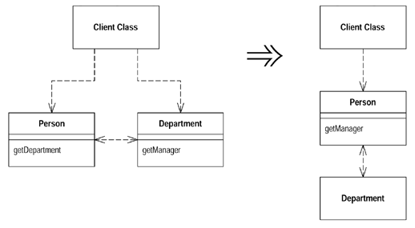
Law of Demeter - Exercise

Slide 45
Tell, don’t ask principle
Object-orientation is about bundling data with the functions that operate on that data
Things that are tightly coupled should be in the same component
Check for cases where some code invokes more than one method on the same object
Do
Tell an object what to do
Don’t
Ask an object for data and act on that data

Slide 46
Immutable and Value objects
Immutable object
An object whose state cannot be modified after it is created
Are inherently thread-safe
Simpler to understand, Higher security
Drawback: copy-on-write
Value object
Equality is not based on identity
Should be immutable
Examples
Amount of money
Date range

Slide 47
Exercise - Length conversion problem
Accept lengths in either meters, inches (2.54 cm) or feet (0.3048 m), and provide ways to compare and convert freely between them
Feet
Meter
Inch

Slide 48
Exercise - Immutable
Make the Planet class immutable

Slide 49
Design by Contract
Viewing the relationship between a class and its clients as a formal agreement
Preconditions and postconditions
Assertion and violation
Class invariants
Client’s obligations
Supplier’s obligations
Inheritance

Slide 50
KISS
KISS – keep it simple
systems work best if they are kept simple rather than made complex
everything should be made as simple as possible, but no simpler (Albert Einstein)

Slide 51
YAGNI
YAGNI - You ain't gonna need it
Should not add functionality until it is necessary
Instead spend time on testing

Slide 52
Packaging
Object-oriented Principles

Slide 53
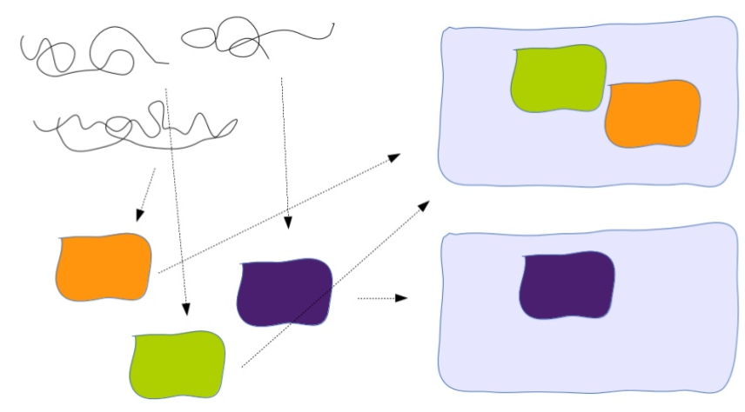
Packaging
Modules
Reduction of complexity
High cohesion, low coupling
For large-scale components

Slide 54
Principles of package cohesion
The Common Closure Principle
SRP for packages
The classes in a package should be closed together against the same kind of changes
A package should not have multiple reason to change
Maintainability may be more important than reusability

Slide 55
Principles of package cohesion
Reuse-release equivalence principle
The granule of reuse is the granule of release
Either all of the classes in a package are reusable or none of them are
Common-reuse principle
Classes that tend to be reused together belong in the same package
If you reuse one of the classes in a package, you reuse them all

Slide 56
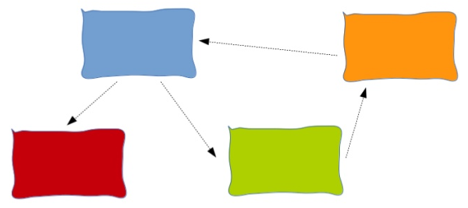
Principles of package coupling
The Acyclic Dependencies Principle

Slide 57
Principles of package coupling
The Acyclic Dependencies Principle
Package graph should be DAG
Solutions
Apply dependency inversion principle
Create a new mediator package
Motivation
Packages in a cycle would become de facto a single package

Slide 58
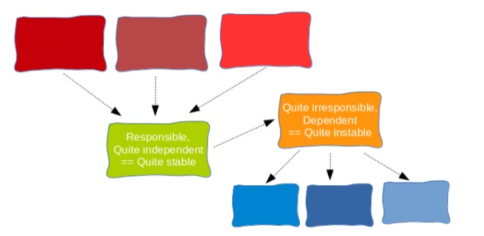
Principles of package coupling
The Stable Dependencies Principle

Slide 59
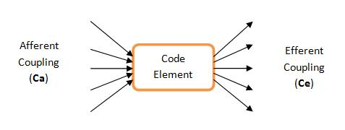
Principles of package coupling
The Stable Dependencies Principle
Depend in the direction of stability
Metrics:
Afferent coupling (Ca), Efferent coupling (Ce)
Instability I = Ce / (Ca + Ce)
The I metrics of a package should be larger than the I metrics of the package that depends on

Slide 60
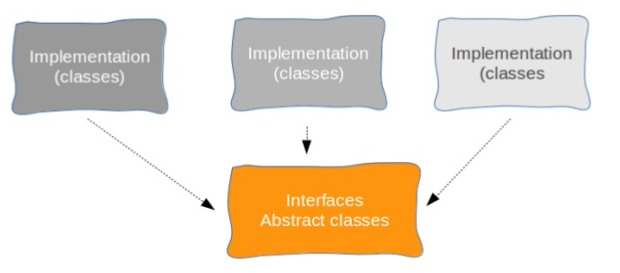
Principles of package coupling
The Stable Abstractions Principle

Slide 61
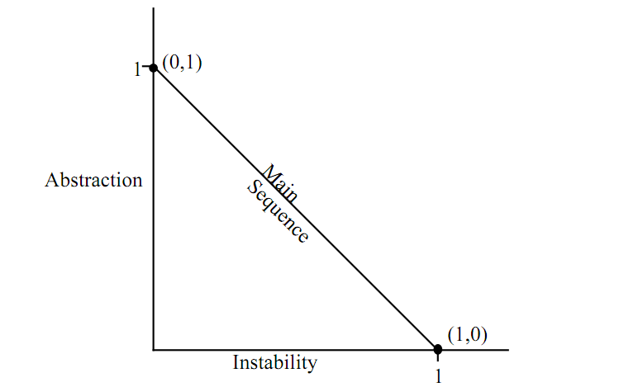
Principles of package coupling
The Stable Abstractions Principle
A stable package should be abstract
An instable package should be concrete

Slide 62
Summary
Core OO concepts
SOLID
Law of Demeter
Immutable and Value objects
Design by Contract
Packaging

Slide 63
Object-oriented Principles
Thanks for your attention!

